Slide 1

Tools for RE and CE: Life Cycle Assessment
Pratishtha
Research Scholar
Indian Institute of Technology Delhi

Slide 2
GREEN PROCESS/PRODUCT?
No use of toxic chemicals
Can be recycled, reused and is biodegradable in nature
Uses the least resources
Is it energy efficient
Has reduced or zero carbon footprint
Has reduced or zero plastic footprint
LIFE CYCLE ASSESSMENT

Slide 3
Life Cycle Assessment
Life-cycle assessment (LCA) is a process of evaluating the effects that a product has on the environment over the entire period of its life thereby increasing resource-use efficiency and decreasing liabilities.
It can be used to study the environmental impact of either a product or the function of the product is designed to perform. LCA is commonly referred to as a "cradle-to-grave" analysis.
LCA's key elements are:-
Identify and quantify the environmental loads involved; e.g. the energy and raw materials consumed, the emissions, and wastes generated.
Evaluate the potential environmental impacts of these loads.
Assess the options available for reducing these environmental impacts.
Notes:
https://www.eea.europa.eu/help/glossary/eea-glossary/life-cycle-assessment#:~:text=Life%2Dcycle%20assessment%20(LCA),use%20efficiency%20and%20decreasing%20liabilities.

Slide 4



Life Cycle Assessment
Goals/Objectives
Aims
Energy efficiency improvement
Pollution prevention opportunity
Greening the supply chain
Marketing, public regulations, regulatory compliances
Comparing alternatives
Product improvement/benchmarking
Resource conservation opportunities
Planning for recycling

Slide 5
LCA can assist in
Identifying opportunities to improve the environmental performance of products at various points in their life cycle.
Informing decision-makers in industry, government, or non-government organizations (e.g. for the purpose of strategic planning, priority setting, product or process design or redesign).
The selection of relevant indicators of environmental performance, including measurement techniques.
Marketing (e.g. implementing an eco-labeling scheme, making an environmental claim, or producing an environmental product declaration).

Slide 6
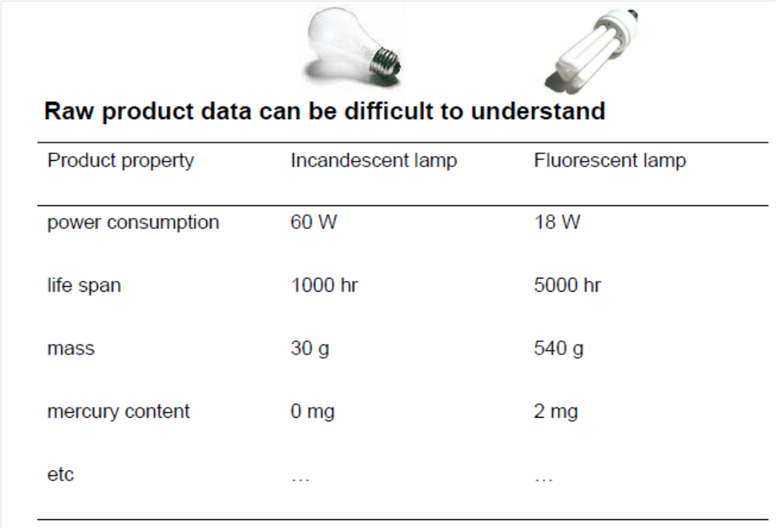
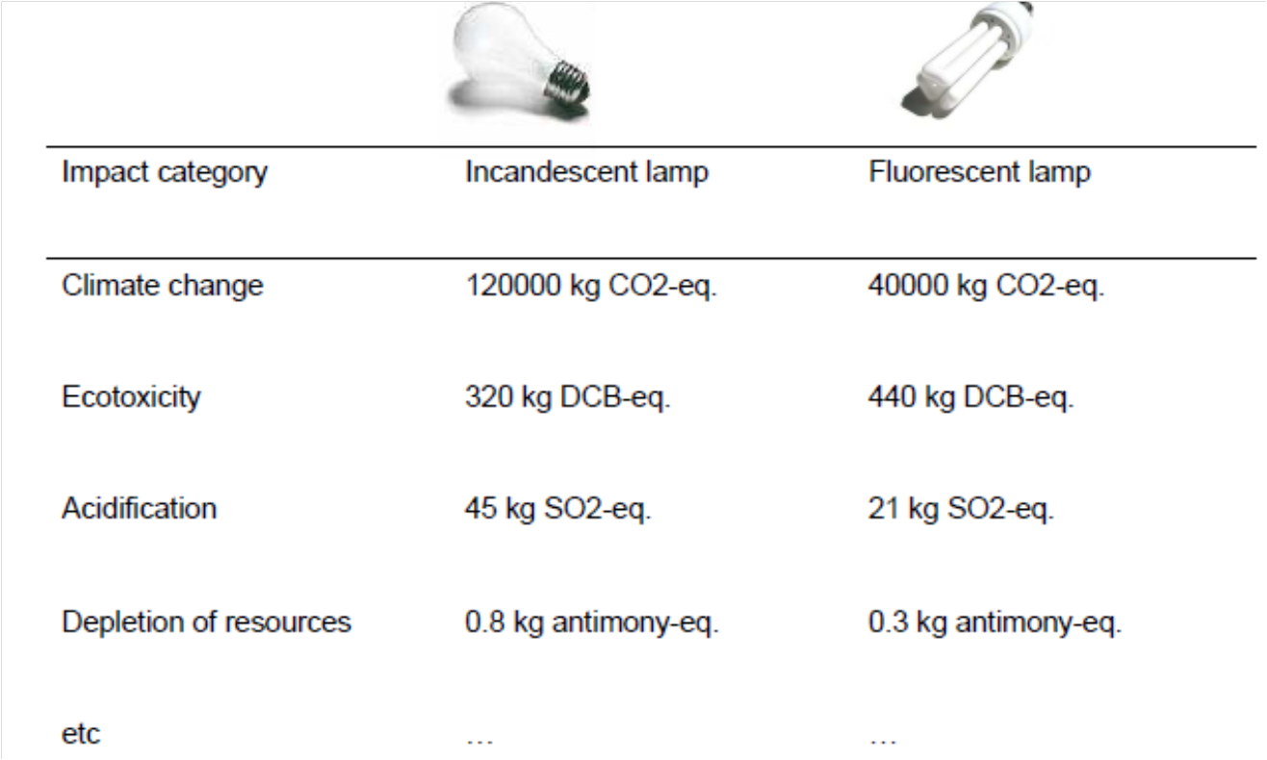
WHY LCA?

Slide 7
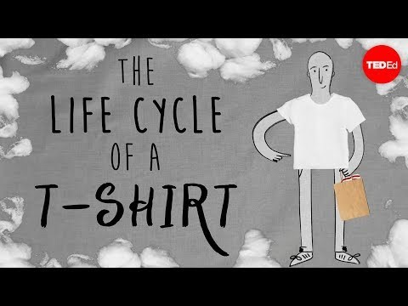
Notes:
https://www.youtube.com/watch?v=BiSYoeqb_VY&feature=emb_logo

Slide 8
Various life cycle phases of a product
Mining
Manufacturing of product
Transformation
Packaging and distribution
End of life
Use of the product
Reuse

Slide 9
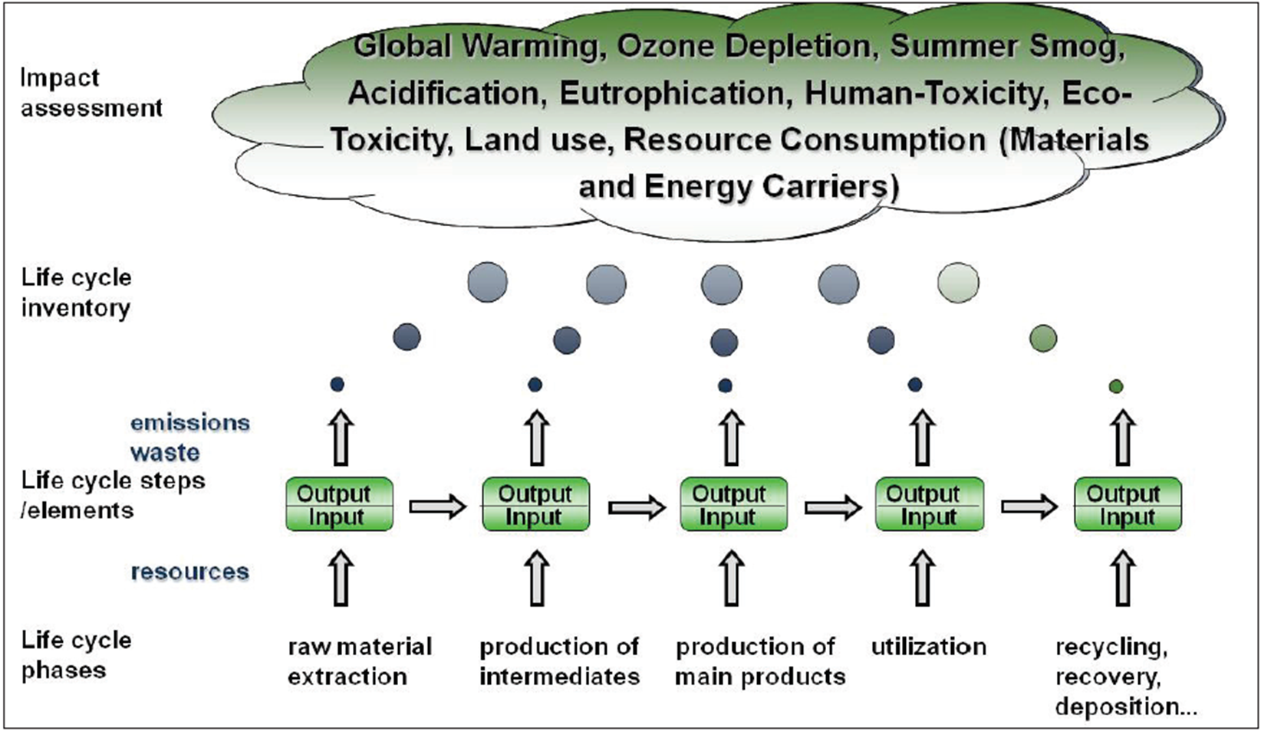
Overview of LCA

Slide 10
ISO Codes
Four standards:
Principal and framework (ISO 14040),
Goal and scope (ISO 14041)
Life cycle impact analysis (ISO 14042)
Life cycle interpretation (ISO 14043).
In 2006 besides ISO 14040 the other three were gathered and included in ISO 14044 without making any change. (Bjorn et al. 2018).

Slide 11

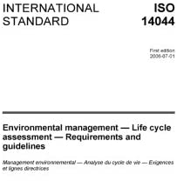
Life Cycle Assessment
The application of LCAs requires both tools (software) and datasets.
Application guided by ISO14044:2006 Environmental management — Life cycle assessment — Requirements and guidelines
Software
Ecochain
Umberto
GaBi Software
SimaPro
openLCA
Database
GaBi
Ecoinvent
ProBas
ELCD

Slide 12
Softwares to Perform LCA
Software | Free version | Software or Online | URL
Ecochain | Yes | Online | https://ecochain.com/
Mobius | Free trial | Online | https://ecochain.com/knowledge/product-environmental-footprint/
openLCA | Yes | Software | https://www.openlca.org/
SimaPro | No | Download | https://pre-sustainability.com/solutions/tools/simapro/
GaBi | No | Download | https://gabi.sphera.com/international/index/
Oneclicklca | Free trial | Online | https://www.oneclicklca.com/
Adopted from Ecochain
Notes:
Adopted from Ecochai, URL: https://ecochain.com/

Slide 13
Life Cycle Assessment
Types of LCA
Singular
Analyzes the environmental impacts of a single product over all lifecycle stages
Comparative
Compares the environmental impacts of different products across all stages
Attributional
Describes the environmentally relevant physical flows to and from a lifecycle system embedded into a static background system
Consequential
Describes how environmentally relevant physical flows will change in response to possible decisions in the analyzed life cycle

Slide 14



Life Cycle Assessment
Examples of LCA Types
Singular
Analysis of (e.g.) greenhouse gas (GHG) emissions of an LED light bulb
Comparative
Comparison between GHG emissions of an LED and incandescent light bulbs
or
Attributional
How much input or output attributed to functional unit
Consequential
How much GHG could be avoided by switching from incandescent to LED lightbulbs in context of a dynamic system?
to
or

Slide 15
Life Cycle Assessment
Define aim, functional unit and system boundary for study.
All the inclusion and exclusion.
Results analysis
Representation
1
Interpretation
Goal & Scope
Life Cycle Analysis
2
4
Impact Assessment
Inventory
Method: ReCiPi 2016, IPCC 2021, CML-IA
Details from inventory analysis serve for impact assessment.
Input and output of material and energy flows.
Especially interaction with environment.
3

Slide 16






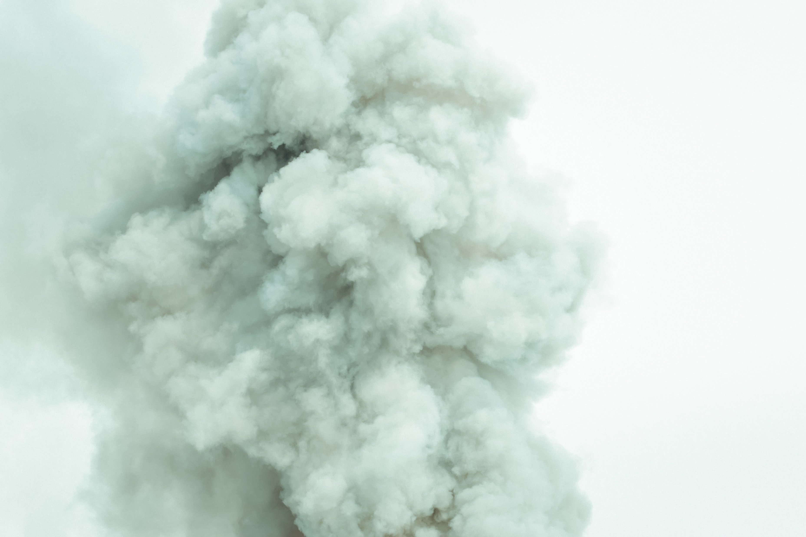





Life Cycle Assessment
Impact Assessment
Industry and manufacturing
Consumer products
Pesticides & fertilizers
Waste
Waste
Medicines and materials
Waste
Workplace Products
Home
Work
Hospital
Agriculture
Soil
Water
Air
Workplace exposoure
Medicines & materials
Food
Drinking water
Consumer products
Plant growth
Drinking water
Air breathing
Non targeted affects
Air breathing
Human
Non-human livings (Ecosystem)

Slide 17
LCA Phases and Process
Stage 1: Goal and scope aims to define how big a part of product life cycle be taken in assessment and to what end will assessment be serving.
Stage 2: Inventory analysis gives a description of material and energy flows within the product system and especially its interaction with environment, consumed raw materials, and emissions to the environment.
Stage 3: Details from inventory analysis serve for impact assessment.
Stage 4: Interpretation of a life cycle involves critical review, determination of data sensitivity, and result presentation.
Goal and Scope
Interpretation
Life cycle Inventory
Impact Assessment
Adopted from: earth-and-planetary-sciences/life-cycle-assessment
Notes:
https://www.sciencedirect.com/topics/earth-and-planetary-sciences/life-cycle-assessment

Slide 18
Functional Unit
A functional unit refers to the product, service, or system whose impacts are calculated by a life-cycle assessment (LCA).
Examples: 1 kg of wheat, 100 calories of food, or 1 ha of land.
The choice of functional unit influences an LCA’s results and care is needed when comparing the results of LCAs with different functional units.
The functional unit is defined in the first phase of a life-cycle assessment study – that of goal and scope definition.
Adopted Life Cycle Assessment Best Practices of ISO 14040 Series
Notes:
Adopted Life Cycle Assessment Best Practices of ISO 14040 Series

Slide 19
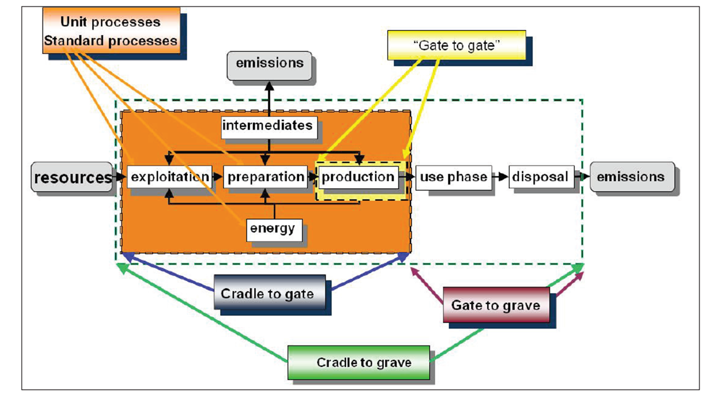
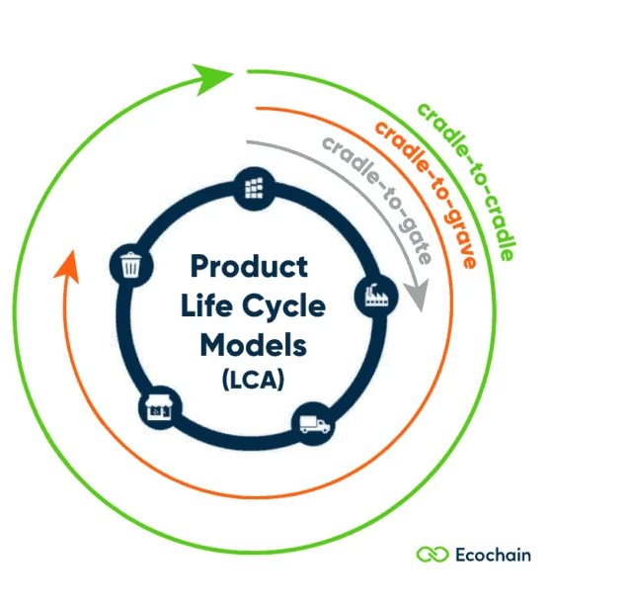
System Boundary

Slide 20
Example: System boundary of Paperboard Manufacturing, Consumption, and Recycling Processes
Wood/Biomass as raw material
Pulping/
bleach-
Pulp
Manufacturing plant
Paperboard
Emissions
Transportation
Packaging
Energy
Folding box
paperboard
Water
Use
Waste
Recycle
Life Cycle Assessment of Paperboard, Pratibha Goyal Degree Thesis Material Processing Technology 2021
Notes:
Life Cycle Assessment of Paperboard, Pratibha Goyal Degree Thesis Material Processing Technology 2021

Slide 21
Fuel (Coal, Biomass, LPG, PNG
Emission
Boiler Ash
Emission due to Machine in collection/Cutting of raw material
Wood/Biomass/Recycled Fiber
Chemical production
Depletion of the forest cover (This can be compensated if similar amount of plantation done
Utility (Boiler)
Transportation of Raw material
Emission due to Transportation of raw material
Water
Steam
Electricity
Electricity
Electricity
Electricity
Water
Electricity
Electricity
WW
Electricity
Electricity
Raw Material Preparation
Pulping
Bleaching and Final Board production
Used in the market
Final Product
Raw Material
Raw Material
Steam
Black Liquor
Electricity
Gas Production
Electricity
Chemical Recovery
WW
WW
Chemical
WW treatment
Chemical
Emission
Emission
Sludge

Slide 22
List of input and output flows
LCA Stages | Inputs | Outputs
Raw material | Wood logs/Biomass Electricity Transport | Wood chips, Wood waste
Digester | Electricity, Heat White liquor (sodium hydroxide, sodium sulphite), Wood chips, water | Pulp, by-product- tall oil, Black liquor (wastewater), Heat Recovery
Refining and bleaching | bleaching (hydrogen peroxide), electricity, pulp, water | Pulp fibers, wastewater
Paper/board sheet forming | electricity, pulp fibers, water, chemicals | packaging paper
Folding box paperboard | electricity, packaging paper | packaging paper
Consumption | electricity, packaging paper, transportation | packaging waste
End of life | Packaging box, heat, transportation | Waste, incineration emission, heat, Recycled pulp
Life Cycle Assessment of Paperboard, Pratibha Goyal Degree Thesis Material Processing Technology 2021
Notes:
Life Cycle Assessment of Paperboard, Pratibha Goyal Degree Thesis Material Processing Technology 2021

Slide 23
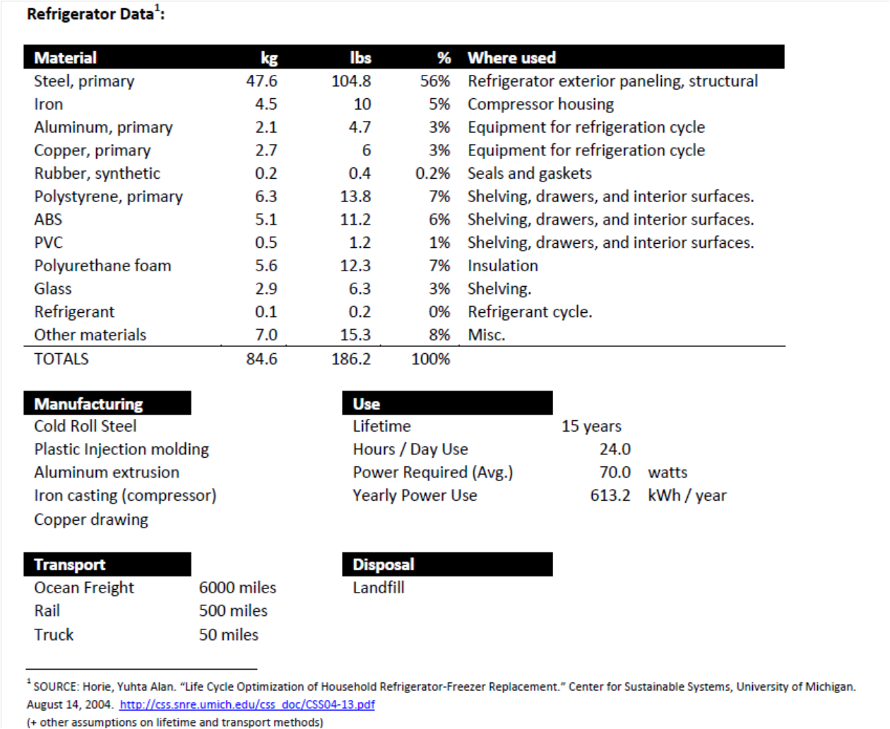
Life Cycle Inventory
Example: Refrigerator

Slide 24
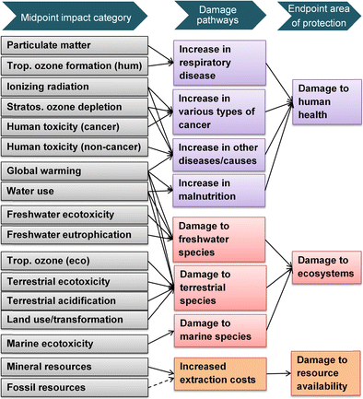
Impact Assessment: Midpoint and Endpoint (ReCiPe 2016 Method)
Characterization factors
Notes:
Adopted from TAPPI PAPERCON MAY 2-5, 2010

Slide 25
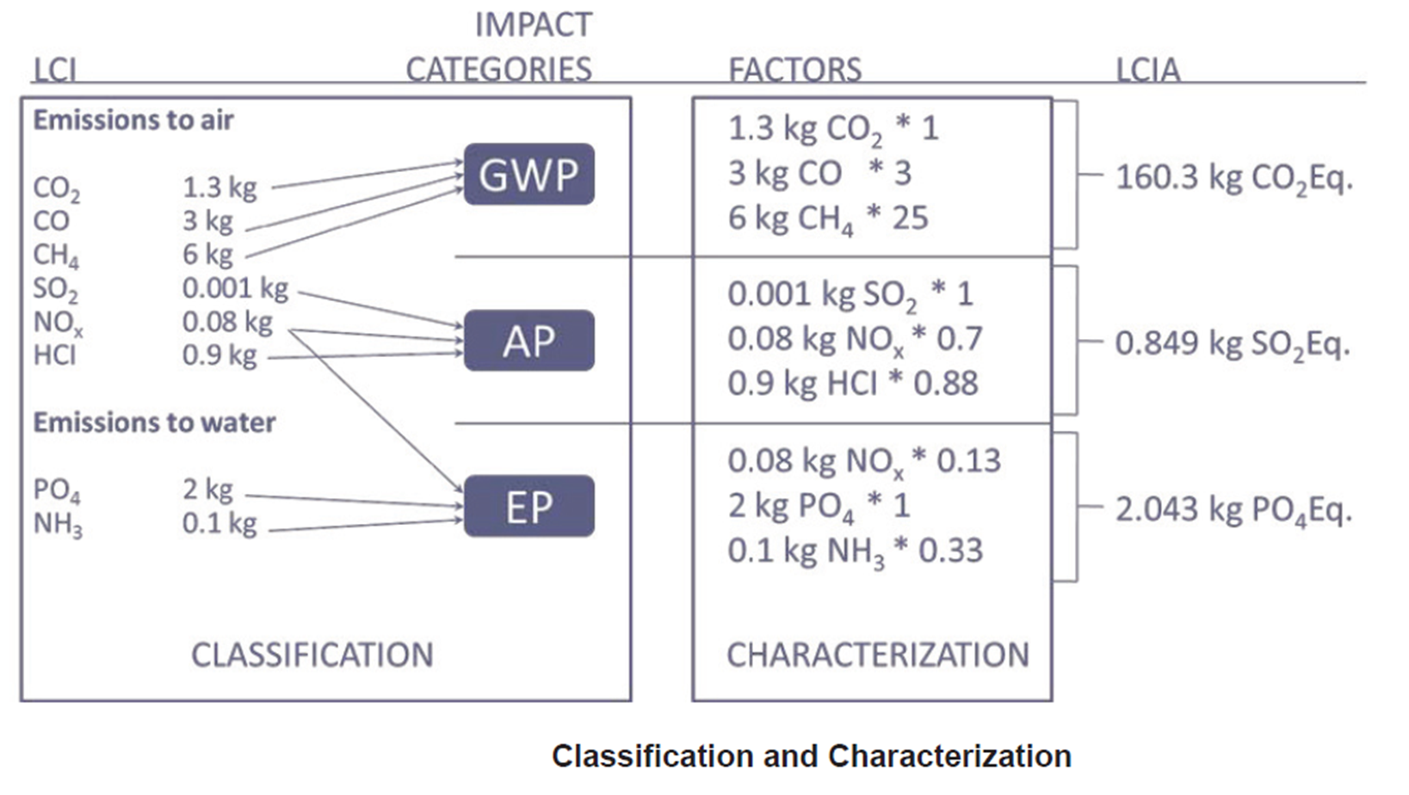

Slide 26
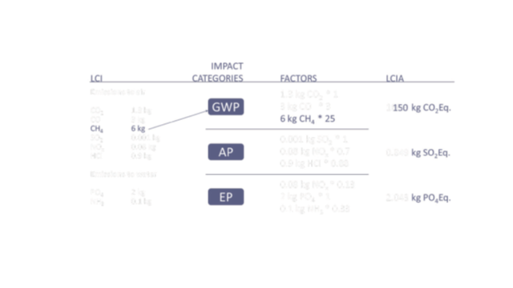

Slide 27
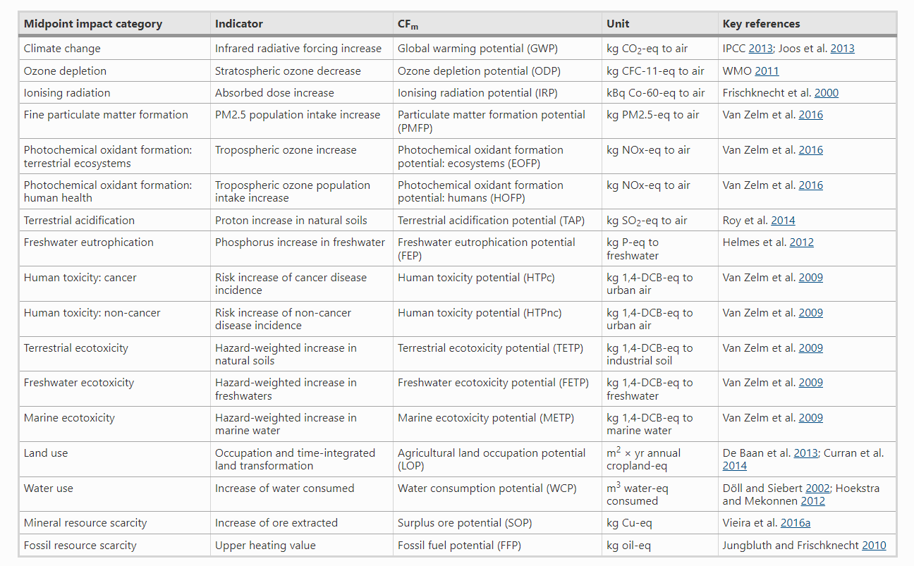

Slide 28
Environmental impacts
Impact category / Indicator | Unit | Description
Climate change – total, fossil, biogenic and land use | kg CO₂-eq | Indicator of potential global warming due to emissions of greenhouse gases to air. Divided into 3 subcategories based on the emission source: (1) fossil resources, (2) bio-based resources and (3) land use change.
Ozone depletion | kg CFC-11-eq | Indicator of emissions to air that cause the destruction of the stratospheric ozone layer
Acidification | kg mol H+ | Indicator of the potential acidification of soils and water due to the release of gases such as nitrogen oxides and sulphur oxides
Eutrophication – freshwater | kg PO₄-eq | indicator of the enrichment of the fresh water ecosystem with nutritional elements, due to the emission of nitrogen or phosphor containing compounds
Eutrophication – marine | Kg N-eq | Indicator of the enrichment of the marine ecosystem with nutritional elements, due to the emission of nitrogen containing compounds.
Eutrophication – terrestrial | mol N-eq | Indicator of the enrichment of the terrestrial ecosystem with nutritional elements, due to the emission of nitrogen containing compounds.
Photochemical ozone formation | kg NMVOC-eq | Indicator of emissions of gases that affect the creation of photochemical ozone in the lower atmosphere (smog) catalysed by sunlight.
Adopted from Ecochain
Notes:
Adopted from Ecochai, URL: https://ecochain.com/

Slide 29
Impact category / Indicator | Unit | Description
Depletion of abiotic resources – minerals and metals | kg Sb-eq | Indicator of the depletion of natural non-fossil resources.
Depletion of abiotic resources – fossil fuels | MJ, net calorific value | Indicator of the depletion of natural fossil fuel resources.
Human toxicity – cancer, non-cancer | CTUh | Impact on humans of toxic substances emitted to the environment. Divided into non-cancer and cancer related toxic substances.
Eco-toxicity (freshwater) | CTUe | Impact on freshwater organisms of toxic substances emitted to the environment.
Water use | m³ world eq. deprived | Indicator of the relative amount of water used, based on regionalized water scarcity factors.
Land use | Dimensionless | Measure of the changes in soil quality (Biotic production, Erosion resistance, Mechanical filtration).
Ionising radiation, human health | kBq U-235 | Damage to human health and ecosystems linked to the emissions of radionuclides.
Particulate matter emissions | Disease incidence | Indicator of the potential incidence of disease due to particulate matter emissions.
Adopted from Ecochain
Notes:
Adopted from Ecochai, URL: https://ecochain.com/

Slide 30
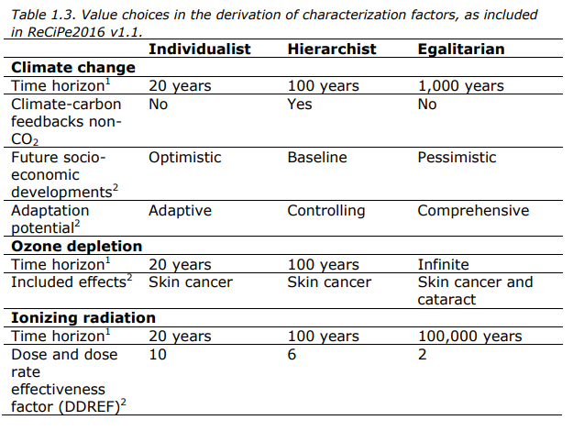
Perspectives in ReCiPe 2016
Table:

Slide 31
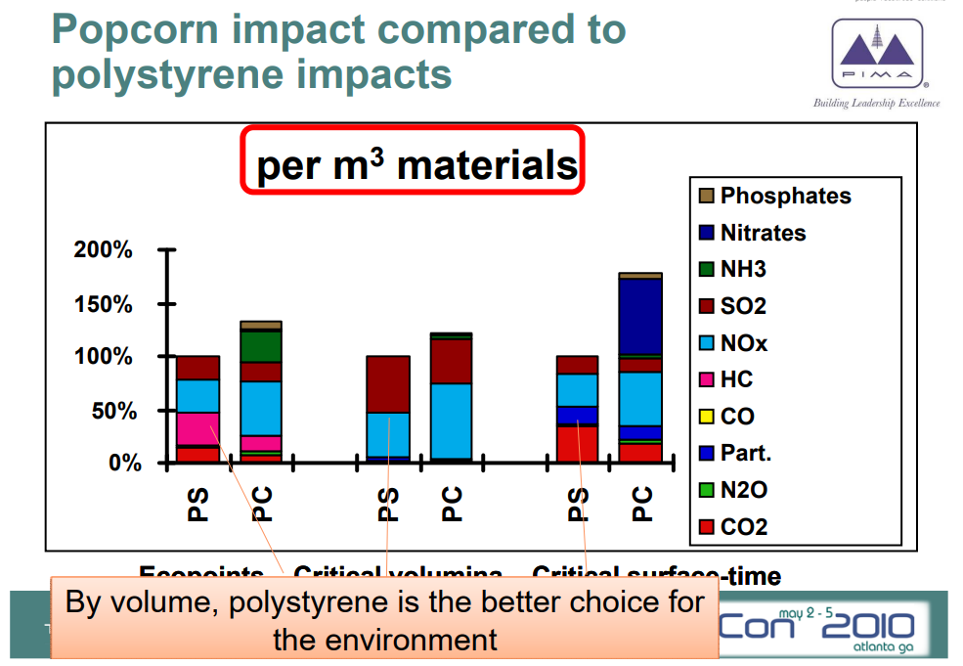
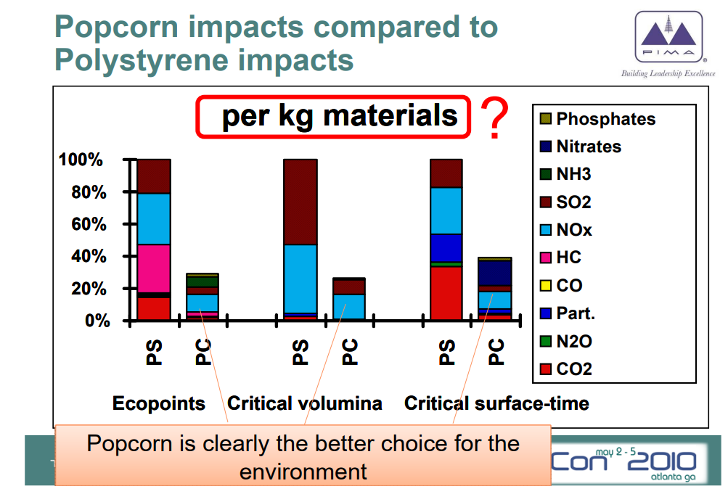
Example: Popcorn vs Polystyrene
Adopted from TAPPI PAPERCON MAY 2-5, 2010
Notes:
Adopted from TAPPI PAPERCON MAY 2-5, 2010

Slide 32
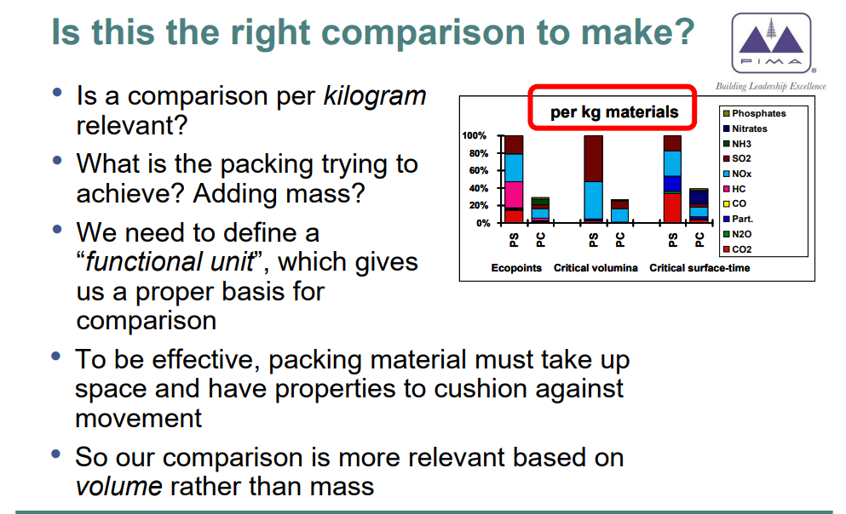
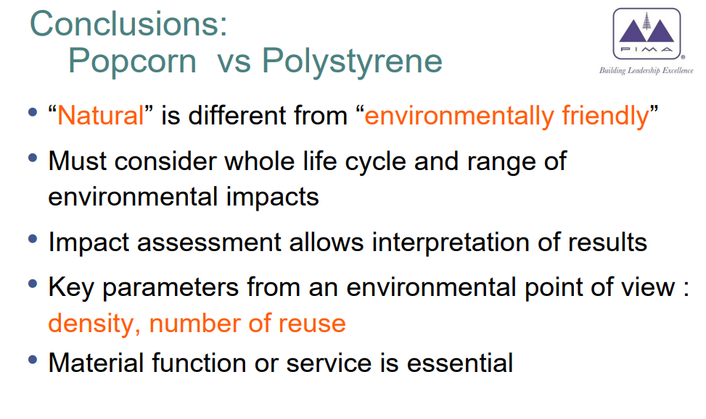
Adopted from TAPPI PAPERCON MAY 2-5, 2010
Notes:
Adopted from TAPPI PAPERCON MAY 2-5, 2010

Slide 33
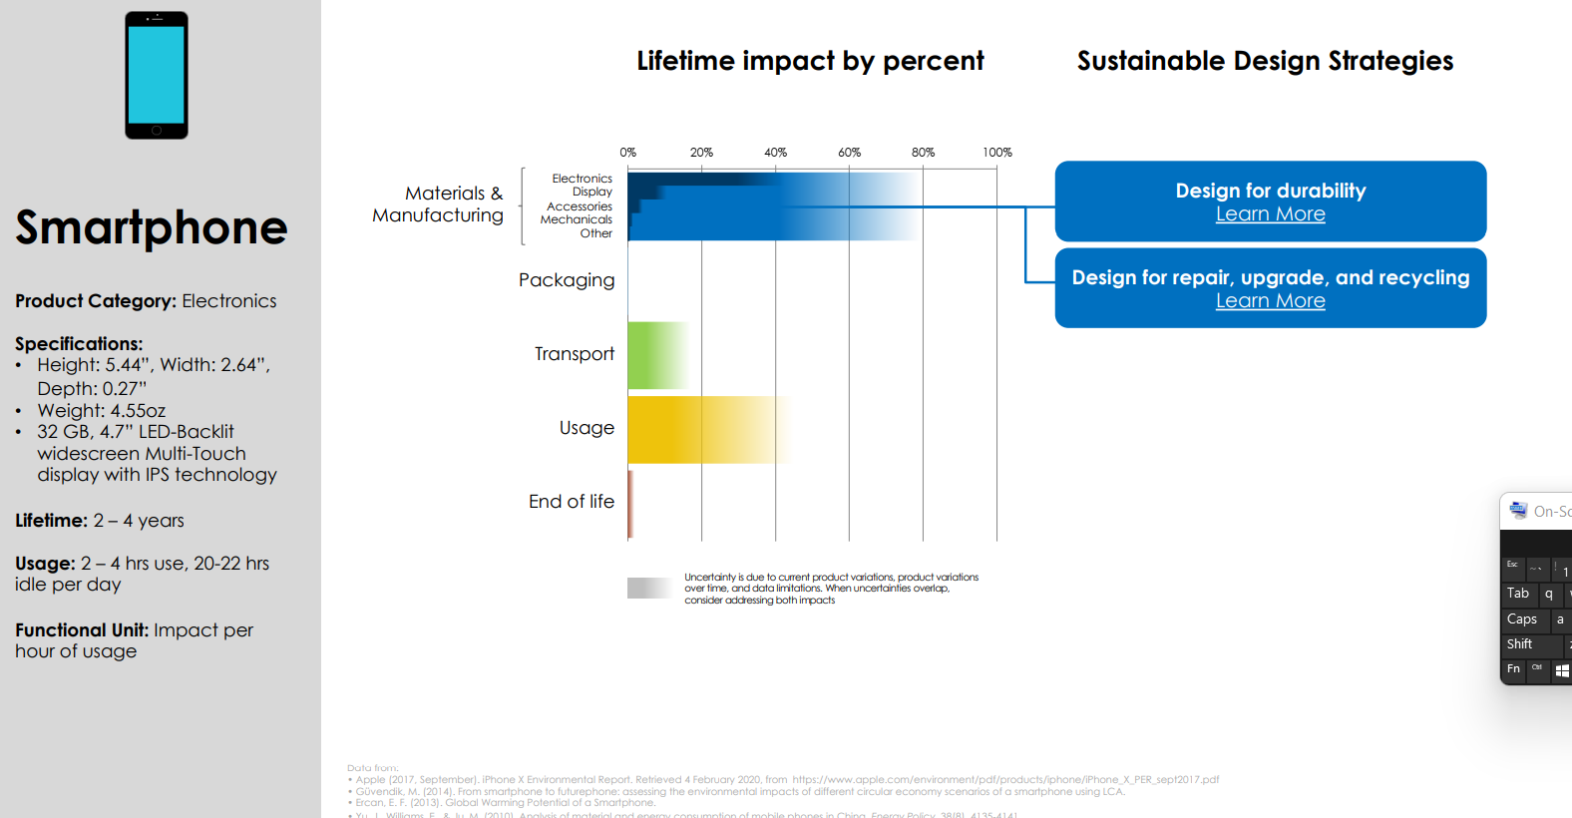

Slide 34
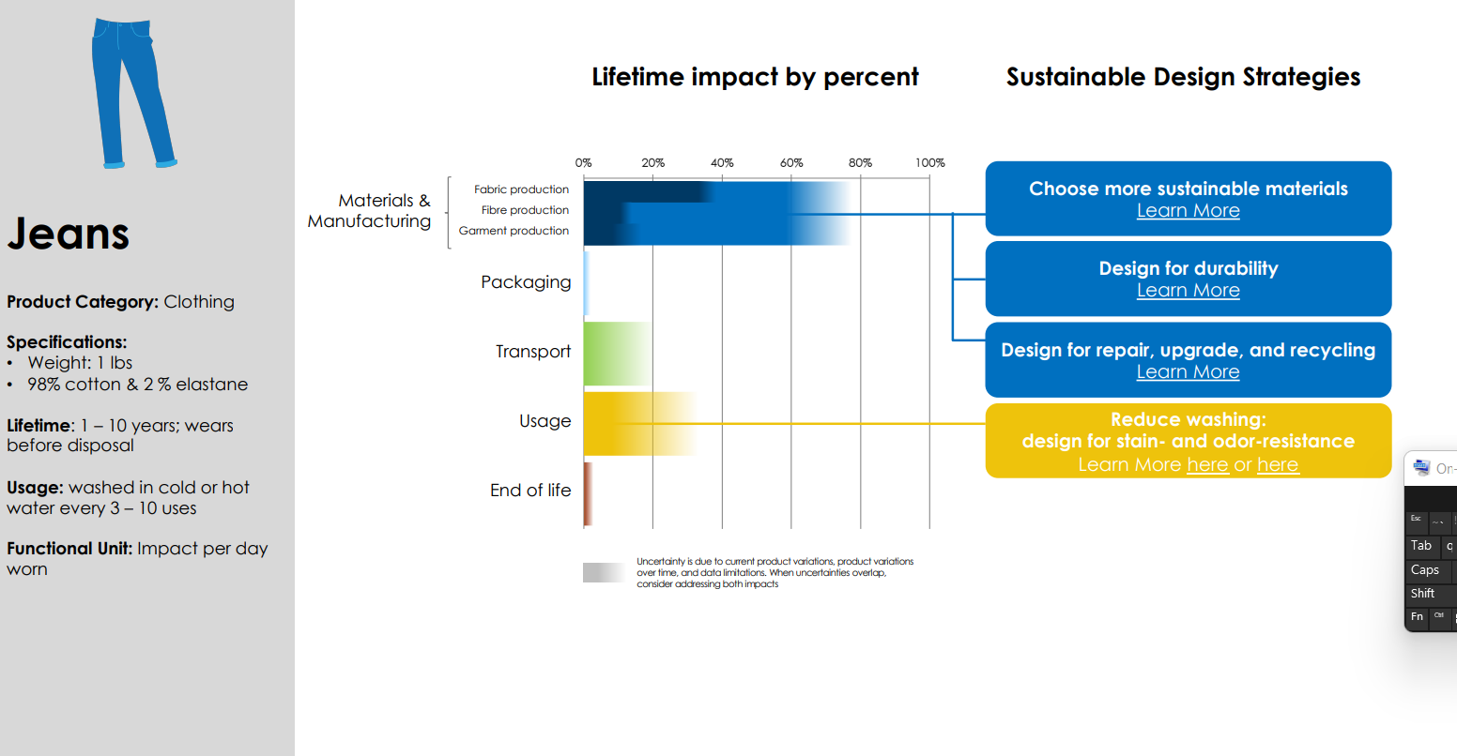

Slide 35
Example 1 – Flow chart of System

Slide 36
Production Overview

Slide 37
Production Details

Slide 38
Environmental Data
Plant A
Plant B
Plant C

Slide 39
Transportation and Energy Production

Slide 40
How much Energy
Energy Carriers equivalent
= 49kWh x 3.6 MJ/kWh = 176 MJ (100 % efficiency?)

Slide 41
How Much Energy

Slide 43
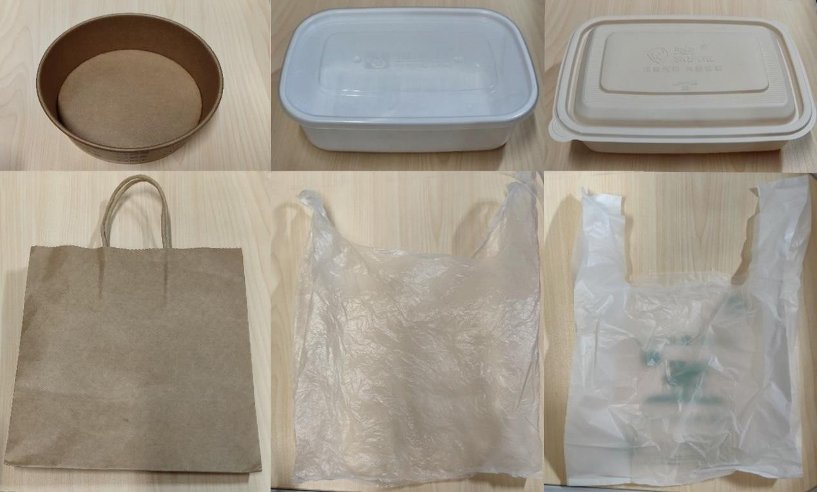
LCA of PP, Paper, and PLA material
LCA comparison of the single-use takeaway packaging using PP, paper, and PLA materials Shuangqi Wu a , Meihan Liu b , Yajing Ma c , Minghao Liud
Notes:
LCA comparison of the single-use takeaway packaging using PP, paper, and PLA materials Shuangqi Wu a , Meihan Liu b , Yajing Ma c , Minghao Liud

Slide 44
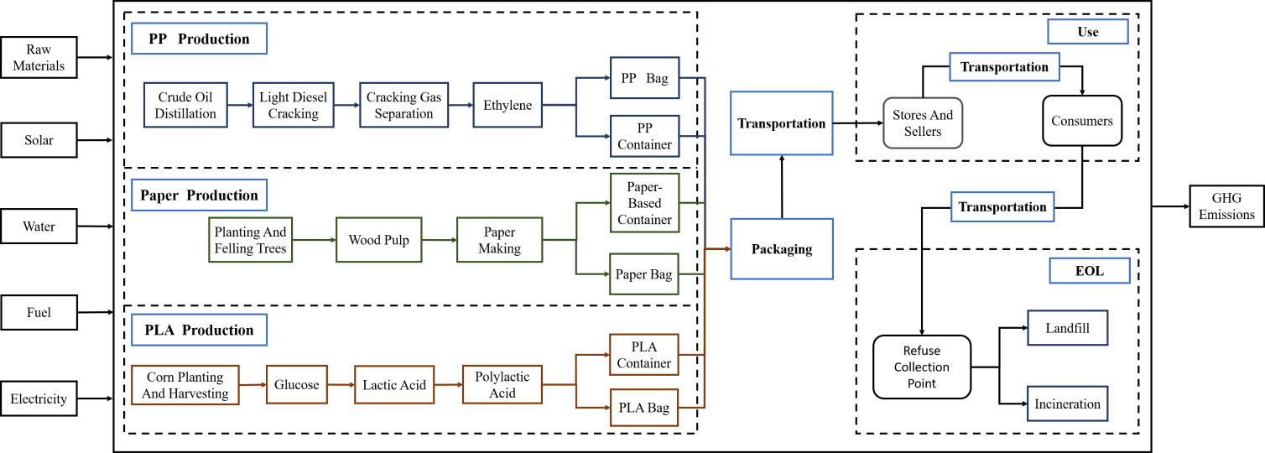
System boundary of PP, Paper, and PLA production
LCA comparison of the single-use takeaway packaging using PP, paper, and PLA materials Shuangqi Wu a , Meihan Liu b , Yajing Ma c , Minghao Liud
Notes:
LCA comparison of the single-use takeaway packaging using PP, paper, and PLA materials Shuangqi Wu a , Meihan Liu b , Yajing Ma c , Minghao Liud

Slide 45
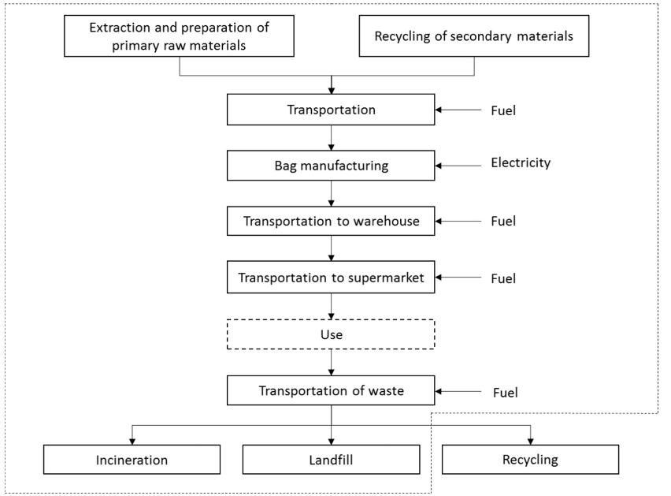
Life cycle assessment of carrier bag
System Boundary
Life cycle assessment of carrier bags and development of a littering indicator Didem Civancik-Uslu a, ⁎, Rita Puig a,b , Michael Hauschild c , Pere Fullana-i-Palmer
Notes:
Life cycle assessment of carrier bags and development of a littering indicator Didem Civancik-Uslu a, ⁎, Rita Puig a,b , Michael Hauschild c , Pere Fullana-i-Palmer

Slide 46
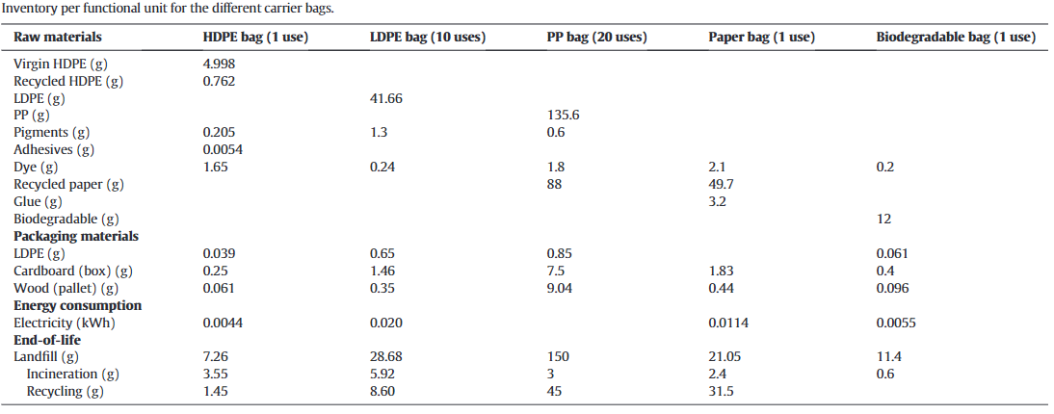
Life cycle assessment of carrier bag
Life cycle assessment of carrier bags and development of a littering indicator Didem Civancik-Uslu a, ⁎, Rita Puig a,b , Michael Hauschild c , Pere Fullana-i-Palmer
Notes:
Life cycle assessment of carrier bags and development of a littering indicator Didem Civancik-Uslu a, ⁎, Rita Puig a,b , Michael Hauschild c , Pere Fullana-i-Palmer

Slide 47
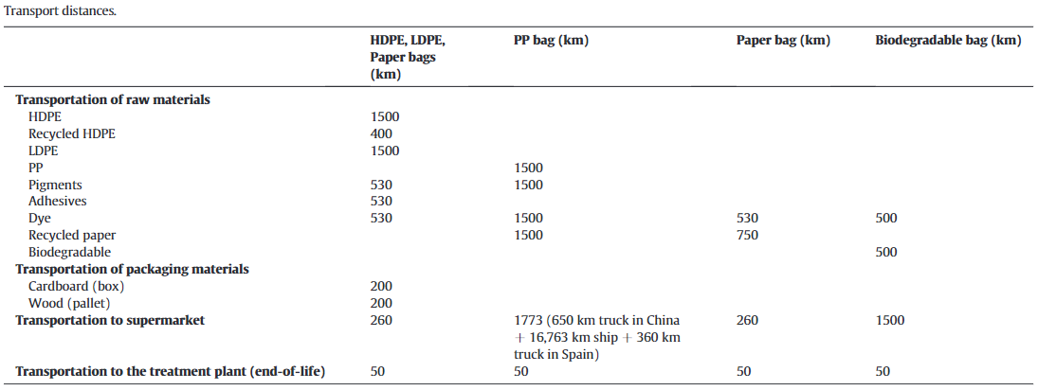
Life cycle assessment of carrier bag
Life cycle assessment of carrier bags and development of a littering indicator Didem Civancik-Uslu a, ⁎, Rita Puig a,b , Michael Hauschild c , Pere Fullana-i-Palmer
Notes:
Life cycle assessment of carrier bags and development of a littering indicator Didem Civancik-Uslu a, ⁎, Rita Puig a,b , Michael Hauschild c , Pere Fullana-i-Palmer

Slide 48
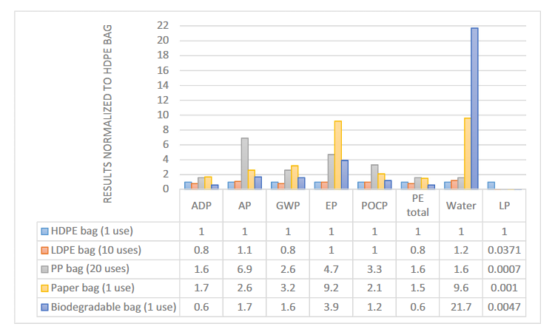
Comparison of the LCA results of different bags (normalized to the HDPE bag)
Life cycle assessment of carrier bags and development of a littering indicator Didem Civancik-Uslu a, ⁎, Rita Puig a,b , Michael Hauschild c , Pere Fullana-i-Palmer
Notes:
Life cycle assessment of carrier bags and development of a littering indicator Didem Civancik-Uslu a, ⁎, Rita Puig a,b , Michael Hauschild c , Pere Fullana-i-Palmer

Slide 49
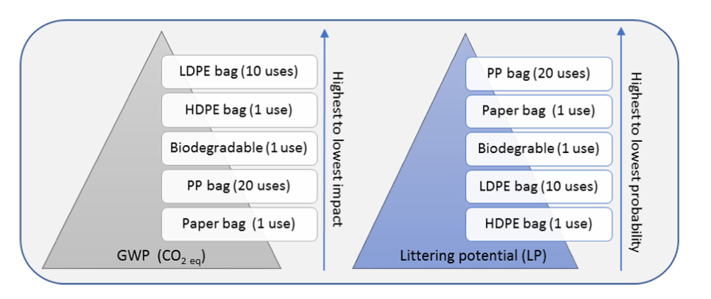
Comparison of global warming potential (GWP) with littering potential (LP) of bags
Life cycle assessment of carrier bags and development of a littering indicator Didem Civancik-Uslu a, ⁎, Rita Puig a,b , Michael Hauschild c , Pere Fullana-i-Palmer
Notes:
Life cycle assessment of carrier bags and development of a littering indicator Didem Civancik-Uslu a, ⁎, Rita Puig a,b , Michael Hauschild c , Pere Fullana-i-Palmer

Slide 50
Life Cycle Assessment
Advantages
Provides a quantitative measurements of a product’s potential impacts
Disadvantages
Resource and time consuming
Allows for an easy identification of most impactful lifecycle stages
Application can capture a wide range of different impacts (GWP, HumToxCan, ODP etc.)
Standardized process in accordance with ISO 14044 creates maximum of transparency and reproducibility
LCA is dependent on consistent, high-quality data (expensive!)
Fast changing innovation cycles (emergence of new technologies) can lead to outdated LCAs
Definition of scope substantially impacts the quality of the LCA

Slide 51
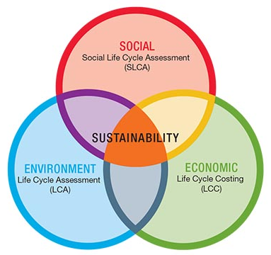
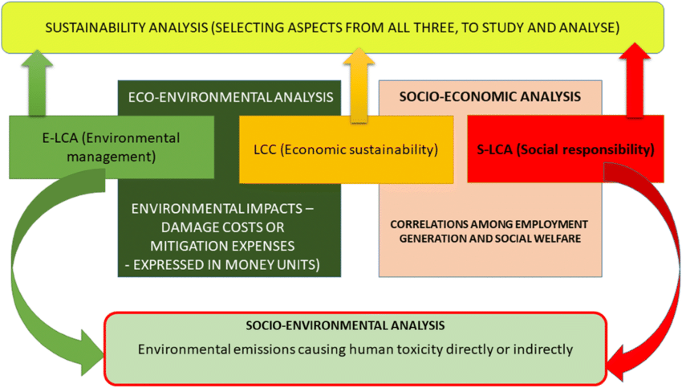

Slide 52
10 min
Exercise:
Estimate the total annual Carbon Footprint (in kgCO2e/yr) of an Indian household involving Electricity Bill (in Rs), Travel (km), Food consumption (kcal), Services utilization (Rs).
Approximate Emission factors are given respectively as
EF(kWh)=35 kgCO₂e/Rs;
EF(km) =0.499 kgCO₂e/km;
EF(Meat)=14.1 kgCO₂e/kcal;
EF(Cereal)=1.3 kgCO₂e/kcal,
EF(Dairy)=4.5 kgCO₂e/kcal;
EF(Veg)=2.8 kgCO₂e/kcal,
EF(Health)=28 kgCO₂e/Rs;
EF(Recreation)=19 kgCO₂e/Rs,
EF(Communication)=0.12 kgCO₂e/Rs.
In balanced diet, a man needs around 2000kcal a day. Assume the other relevant details.
Food Item | Avg Calories kcal/100g or mL
Grains (All) | 330
Lentils | 290
Vegetables | 40
Roots, tubers, fruits | 60
Dairy products | 150
Meat | 200

Slide 53
Exercise
In an integrated sugar industry, sugar is extracted from sugarcane. 1 tonne of sugarcane produces 95 kg of sugar an 11 L of ethanol. Sugarcane is first washed on rotating drums and crushed. Sugarcane juice and bagasse is obtained from sugarcane by milling. This juice is purified by sulfitation process follow by carbonation to further separate the soluble non-sugar materials from the sugar juice. Carbonation employs calcium carbonate or calcium sulfite to aid in precipitation. The juice is heated to denature the protein content and is then mixed with a slurry of calcium hydroxide. The obtained juice is then boiled in a series of vacuum evaporators until it reaches a concentration of 50%–65% sugar. A syrup is obtained after purification and a milky solution of pure sucrose suspended in alcohol and glycerin is slowly added as seed for crystallization and is boiled in a vacuum pan. Further, to separate the massecuite (paste obtained after crystallization) into sugar crystals and molasses (45 kg), the massecuite is added to a high-speed centrifuge. The damp sugar crystals are dried, and molasses is processed in the distillery to give alcohol.
Describe the material flow chart and input-output of the system.

Slide 54
THANK YOU

Slide 55
Exercise
Case Study:
For agro-residue-based paper production, 500 kg of dried biomass is processed to 250 kg of paper. A digestor is used to process biomass to pulp with addition of 2.5 kL of water and 100 kg of chemicals. After digestion (in a pressure vessel by heating upto 160º) for 2 hours, 2.5 kL is liquor is generated and the pulp obtained is refined and after addition of 25 kg fillers & chemicals dried to produce 250 kg of sheets. Analyze the process and define the goal & scope and prepare a life cycle inventory for the above case.

Slide 56
Social Life Cycle Analysis
Social- social benefit accrued throughout the life cycle of product and process
Local Economy
Cost- net present value of product and process
Livelihood opportunities
Annual burden towards environmental conservation
Vis-à-vis annual turnover ratio
=
Annual turnover of the company
Socio economic indicators
Gender participation

Slide 57
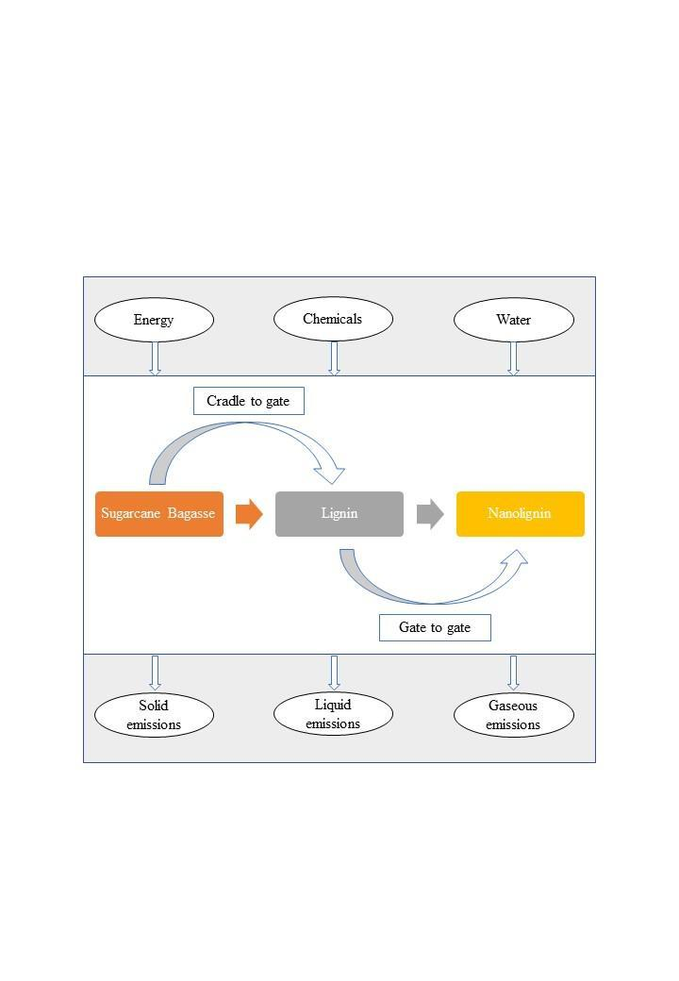
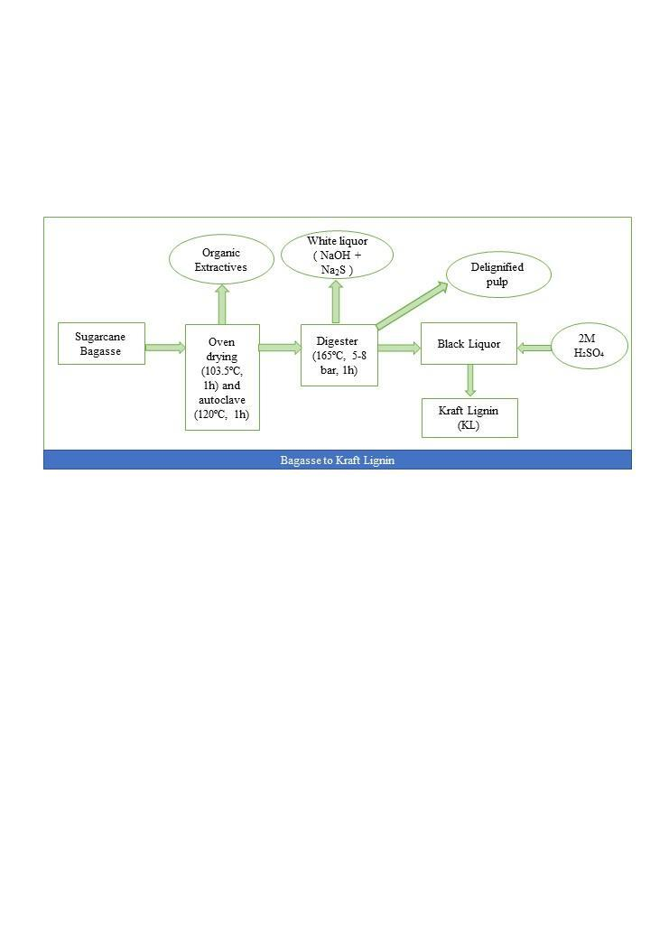
SYSTEM BOUNDARY FOR NANOLIGNIN SYNTHESIS

Slide 58
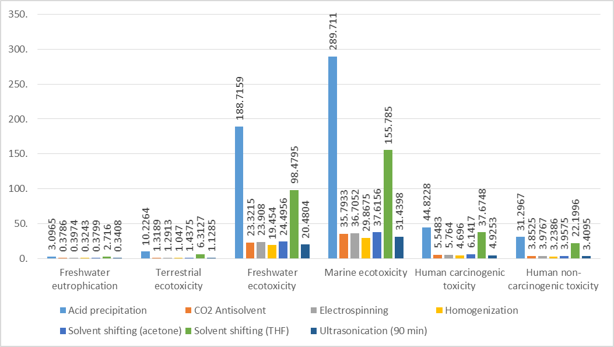
MID POINT ANALYSIS

Slide 59
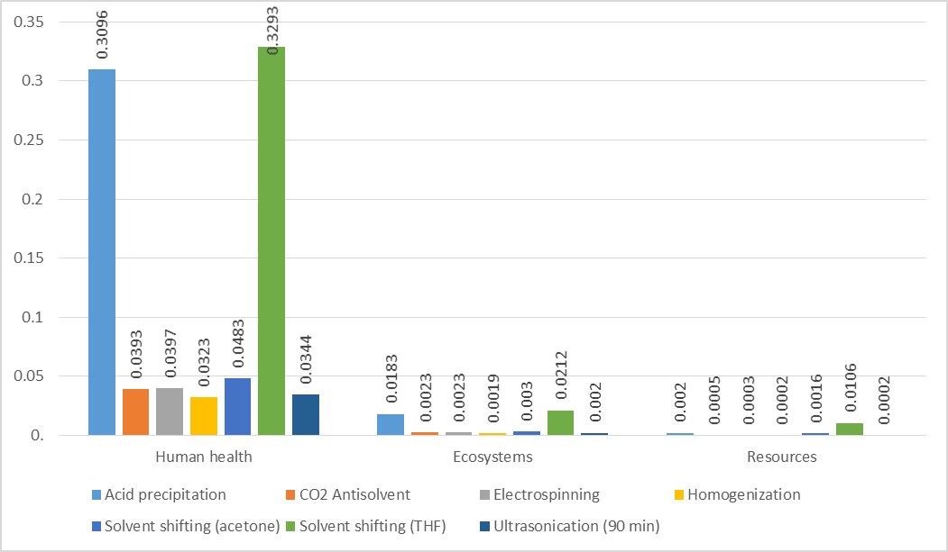
END POINT ANALYSIS

Slide 60
Life Cycle Assessment
Outcomes
Operational Footprints
Technological Interventions, suggestions
Product footprint
Environmental footprint of all the company operations
Footprint of product manufacturing.
Identify areas for improvements.
Standardized Reporting
Benchmarking best practices
Reporting the results as per standard guidelines.
Identify and suggest better operational practices.

Slide 61
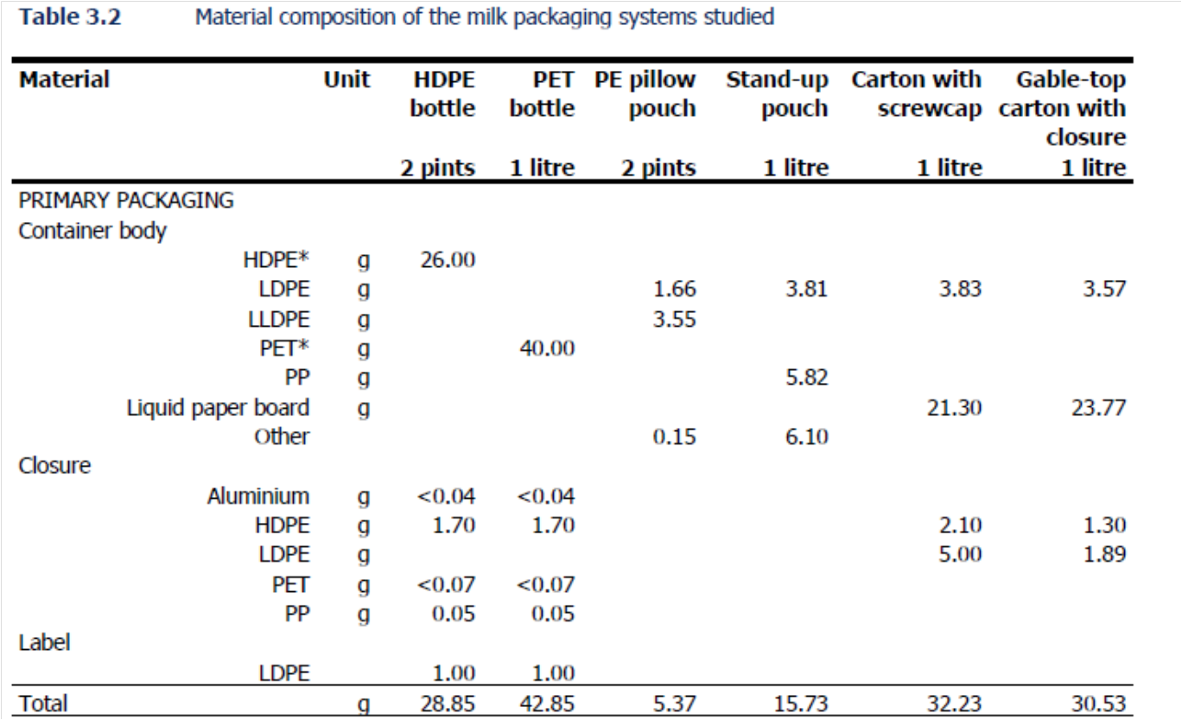

Slide 62
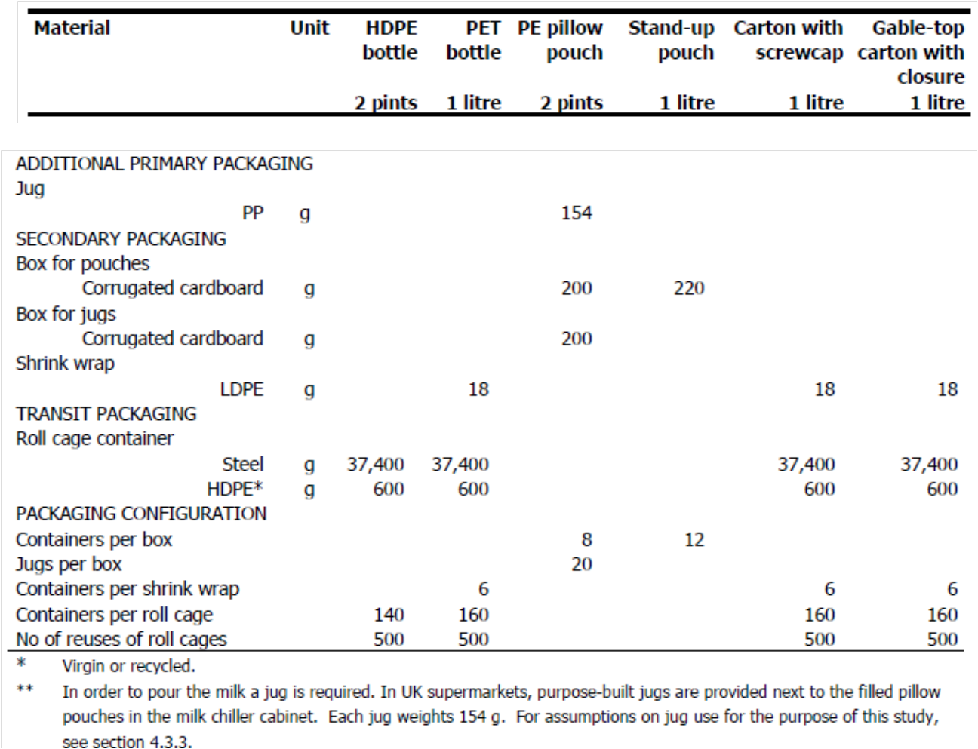

Slide 63
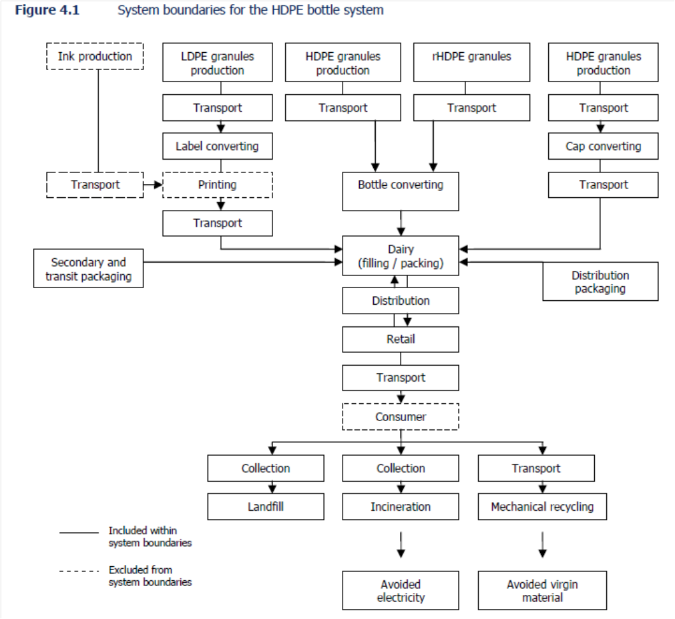

Slide 64
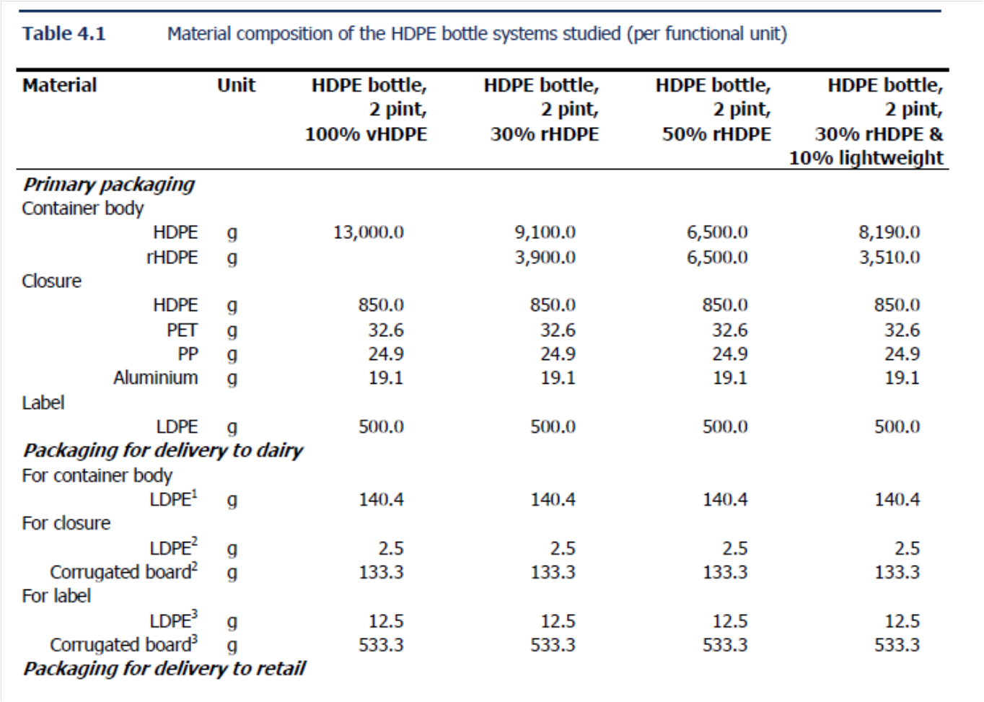

Slide 65
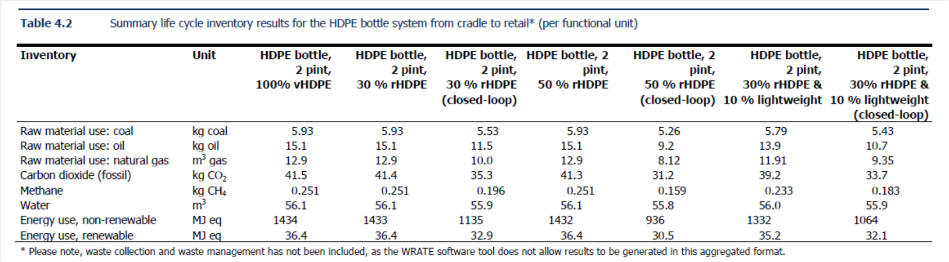

Slide 66
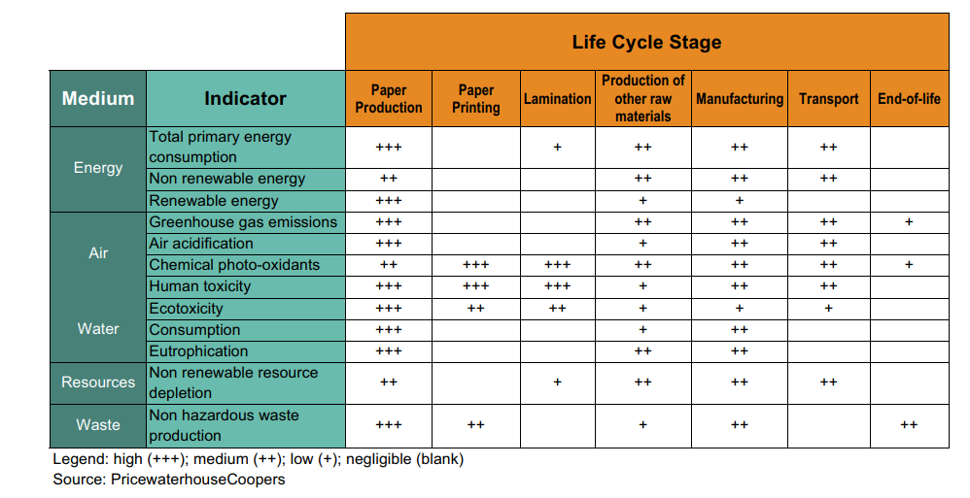
Product-wise Severity for Environmental Impact
Life Cycle Assessment and Forest Products: A White Paper September 2010
Notes:
Life Cycle Assessment and Forest Products: A White Paper September 2010

